Slide 1
INFORMATION SYSTEM for LIAISON COMPANY
Submitted By
Manish Mahesh Mayekar | 12IT5017
Salman Parvez Dangra | 09IT1014
Raza Abbas Syed | 10IT1009

Slide 2
Introduction
Agri Chemicals Limited is liaison company who acts as a link to assist communication or corporation between two parties.
The company is established in the year 2002 & incorporated in United Kingdom. The company branch office is located in Andheri, Mumbai. Company deals with variety of products like – Tiles, chemicals, paint, machinery and part manufacturer and etc.
Notes:
Liaison – By the reference from the oxford dictionary liaison means Communication or cooperation which facilitates a close working relationship between people or organizations.

Slide 3
Problem Statement
The current system is too time consuming. The existing system makes use lot of paper. It is difficult to keep track of data or make any modification in the stored data. Although another problem lies are storage and printing materials.
So our main aim is to develop a system that will easily store such details in less time and uses no paper at all if possible.

Slide 4
Overview of the System
The client make requests towards company for the services which resulted in generation of OPR.
OPR then circulated to the company’s suppliers. suppliers submit their quotes. Company choose the best quote and send to the client.
On the approval of client company generates OPO and send its copy to both client and supplier.
All documentation is done in paper work mode.
Notes:
OPR – Overseas Purchase Requisition
OPO – Overseas Purchase Order

Slide 5

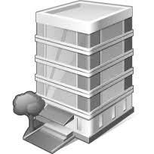

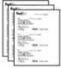


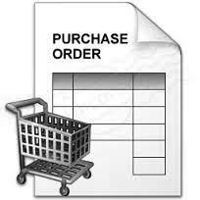



Block Diagram of System
Send Order
Send OPR
Send Quotation
Send Quotation
Approve Quotation
Send OPO
Send OPO
Customer
Agri Chemicals Limited
Supplier
Receive Order from Customer
Generate OPR Document
Receive Quotes from Suppliers
Select Best Quote for Customer
Generate OPO Document
Mail the OPO to
Supplier & Customer
Receive Order from Supplier
Ship order to Customer

Slide 6
Limitations of Existing System
The security of the data is most common concern with the previous system.
The previous system is more time, space & money consuming because of data storage.
Storage of data and process of maintaining data is very lengthy and bulky in nature.
System is not suitable from environmental point of view.

Slide 7
Requirement Analysis
The administrator can view day to day activities of executive in the company.
The executives can Create, Edit and Print the OPO and supplier details.
The administrator should Manage and Control all executives of the company.
Ability to Upload excel file sheets in GridView to save the time and efforts of executives.

Slide 8
Proposed System
Proposed system store historical data in electronic data form instead of paper work data which happened in the past.
Proposed system works in following way :
Client Side System :
Variety of forms to store information
Server Side System :
Obtaining employee activities on day to day basis

Slide 9



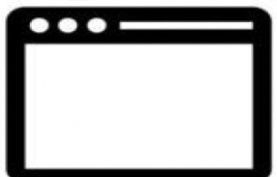
System Design
System Architecture Diagram
SQL Server 2008 R2
Employees
Agri Chemical Ltd.
Database
Server Side
Desktop Application
Supplier
Details
OPR
Details
Client Side
Desktop Application
Administrator
Manage Employee details
and View their activities

Slide 10
Use Case Diagram
Agri Chemicals Limited
Information System
Login
Manage employee account details
View employee daily activities
Respond to OPR deletion Request
Administrator
Manage Supplier Details
Manage OPR Details
Print or View Supplier or OPR details
Employee
Generate Supplier or OPR deletion Request

Slide 11
Data Flow Diagram Level 0
Administrator
Login
Authentication
Manage Employee details & Activities
Respond to OPR and Supplier deletion Request
Generate OPR and Supplier
Deletion Request
0
Agri Chemical Ltd.
Information System
Login
Employee
Authentication
Manage OPR and Supplier Details

Slide 12
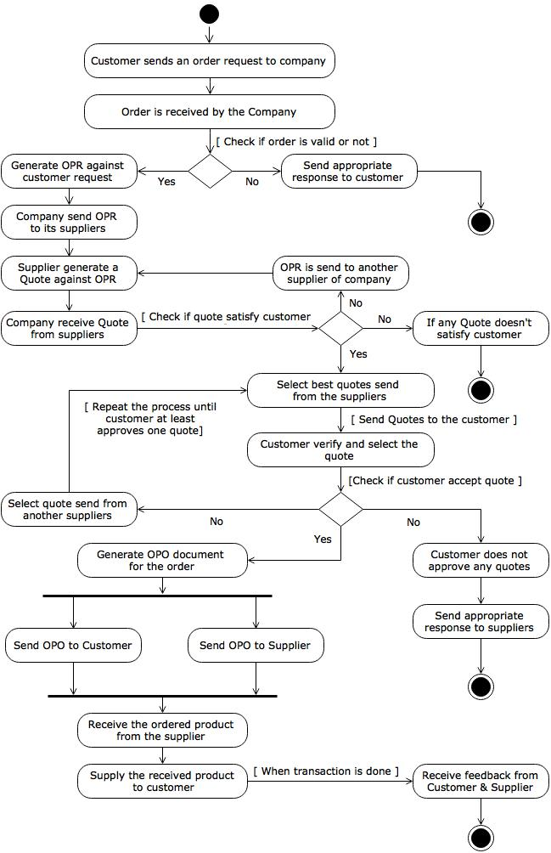
Activity Diagram

Slide 13
Technologies Used
.NET Framework 3.5 and above
VB.NET 2010
TL-SQL

Slide 14
Technical Requirements
Hardware Requirements
Server Side
Processor : Pentium 4.0 or above
HDD : 120 GB
Client Side
Processor : Pentium 4.0 or above
HDD : 40 GB
RAM : 2 GB or above
RAM : 1GB or above

Slide 15
Software Requirements
Server Side
Operating System : Microsoft Windows XP
Client Side
Operating System : Microsoft Windows 7 or above
Database Client : Microsoft SQL Server 2008
.NET Platform : .NET Framework 4.0 or above
.NET Platform : .NET Framework 4.0 or above
Database Server : Microsoft SQL Server 2008
Development IDE : Microsoft Visual Studio 2010 IDE

Slide 16
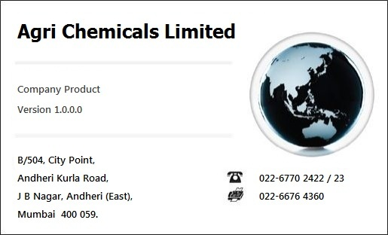
Snapshot of System
Splash Screen

Slide 17
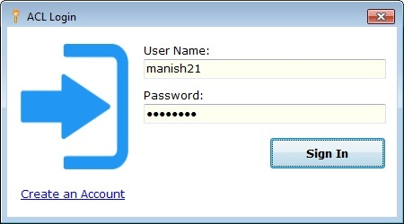
Login Window

Slide 18
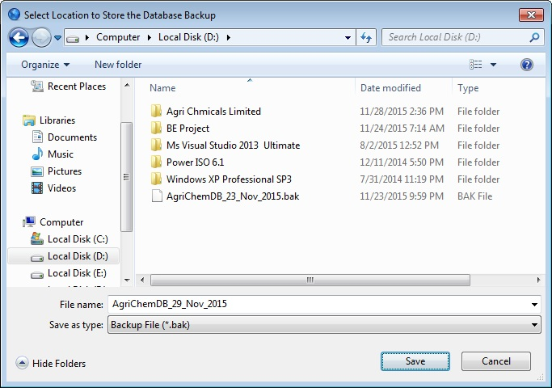
Create Backup

Slide 19
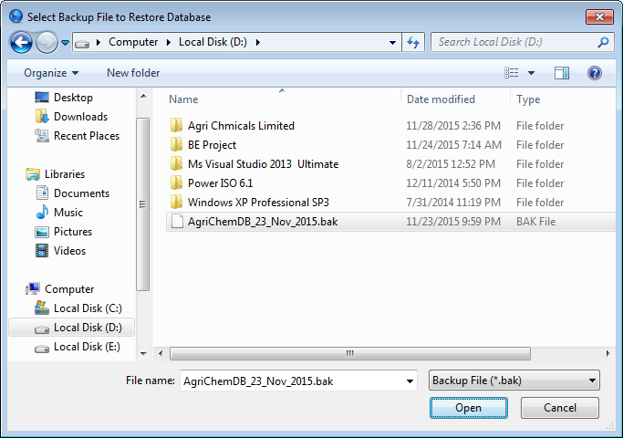
Restore Database

Slide 20
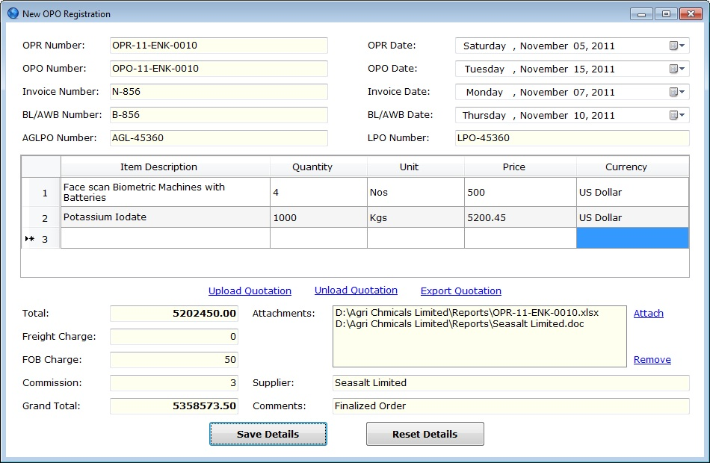
New OPO Registration

Slide 21
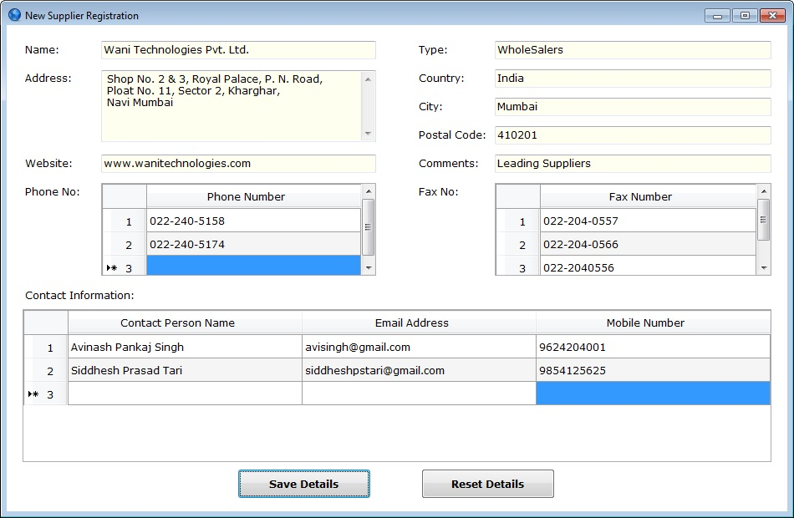
New Supplier Registration

Slide 22
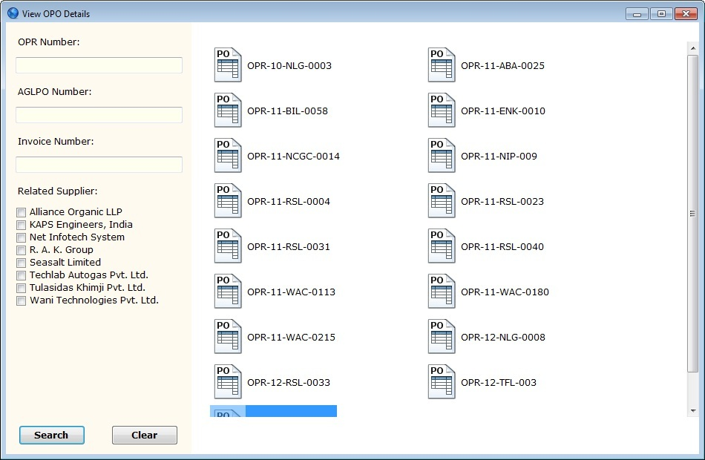
View OPO Details

Slide 23
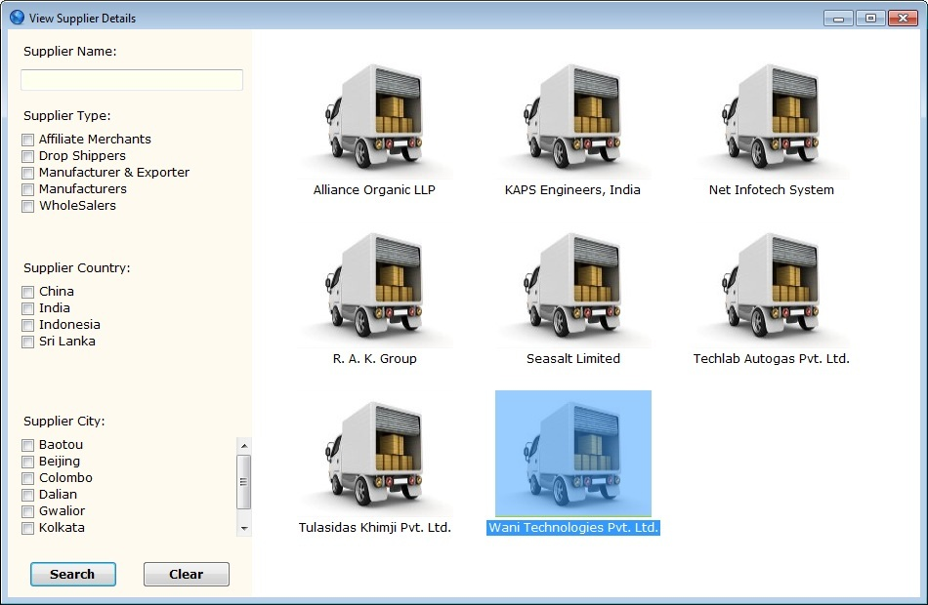
View Supplier Details

Slide 24
Advantages of New System
The new system used in the company is more time saving than the existing one.
Minimum use of paper and other printing materials maintain cost effectiveness.
Less use of Papers and other stationary stuff make this system more environmental friendly.
The real time data can be handled by this system, so it will decrease the workload of executives.

Slide 25
Disadvantages of New System
New system works in client-server environment, so if the server fails entire network collapse.
Data stored in the system is not in the encrypted format therefore it will leave some security issues while storing the information.
Entire system is developed in the .NET Framework, so it lack behind while running on other OS, which are other than WINDOWS.

Slide 26
Conclusion
This computerized system will start a new era in the mentioned company environment, where each employee of the company is able to use this system to maintain and secure their precious information.
This information is store in very friendly manner without wasting any time and economic resources on the stationary and printing materials, storage areas and man power.

Slide 27

THANK YOU

